Slide 1
Inverting Physical Models with Particle Swarm Optimization
Matthew Gardner
Advisor:
Dr. Kevin Seppi

Slide 2
The Scientific Method
Take data, make calculations to find the parameters you want
Focal length of a lens
Planck’s Constant

Slide 3
The Scientific Method
Sometimes you can’t produce a formula - to solve these problems, different techniques are required
So instead of making direct calculations from data, you can calculate what the data would be with different parameters
Minimize squared error
Can particle swarm optimization be used?

Slide 4
Double Arm Pendulum
We find out the mass of the attached objects
Difficulties: when more than one type of parameter is varied, there are multiple possibilities

Slide 5

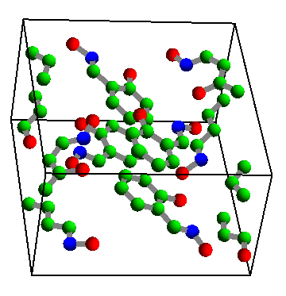
Crystallography
Shine x-rays through a crystal
Look at the light that comes out
Infer the structure of the crystal

Slide 6
Crystallography
Originally: 20 atoms, 3 free parameters each
Various simplifications
Right now: 2 molecules, 6 parameters each

Slide 9
Future Work
Increase the number of variables - solve the whole problem
More interesting problems that we don’t know the answer to

